Slide 1
Capstone Project - The Battle of Neighborhoods
By: Sharmili Tandulwadkar

Slide 2
Introduction: Business Problem
The Vancouver City is a major city in western Canada, located in the Lower Mainland region of British Columbia.
The project aims to find a safe and secure location for opening of grocery store in Vancouver, Canada.
The project will be targeted to stakeholders interested in opening a Grocery Store in Vancouver City, Canada.

Slide 3
Data Description
Dataset from Kaggle containing the Vancouver Crimes from 2003 to 2019 https://www.kaggle.com/agilesifaka/vancouver-crime-report/version/2
The information about the Neighborhood from Wikipedia https://en.wikipedia.org/wiki/List_of_neighbourhoods_in_Vancouver
The data will be fetched using OpenCage Geocoder to find the safest borough and explore the neighborhood by plotting it on maps using Folium and perform exploratory data analysis.
The data will be fetched using Four Square API to explore the neighborhood venues and to apply machine learning algorithm to cluster the neighborhoods and present the findings by plotting it on maps using Folium.

Slide 4
Methodology
Exploratory Data Analysis: Visualize the crime reports in different Vancouver boroughs to identity the safest borough and normalize the neighborhoods of that borough. We will Use the resulting data and find 10 most common venues in each neighborhood.
Modelling: To help stakeholders choose the right neighborhood within a borough we will be clustering similar neighborhoods using K - means clustering which is a form of unsupervised machine learning algorithm that clusters data based on predefined cluster size.

Slide 5
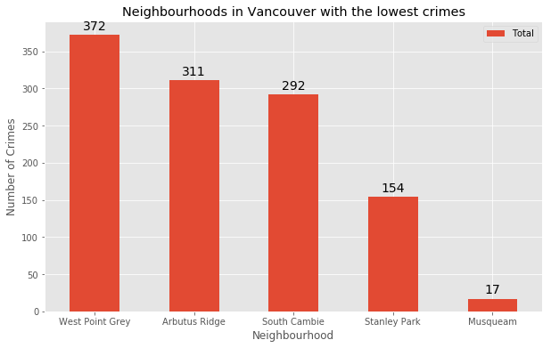
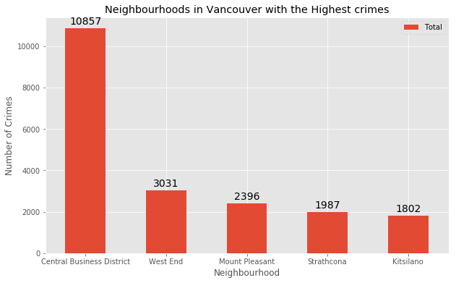
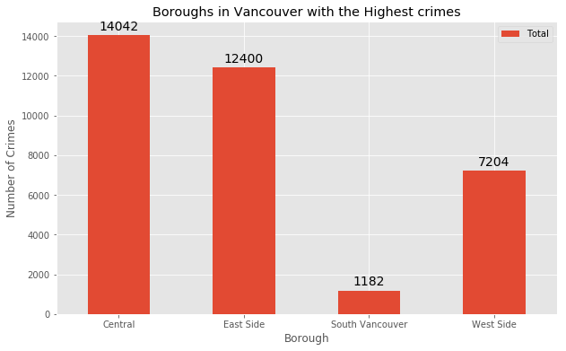
Exploratory Data Analysis
Based on exploratory data analysis it is clear that South Vancouver has the lowest crimes
Since South Vancouver has very little number of neighborhoods and opening a commercial establishment would not be viable, we can choose the next borough with lowest crime which is West Side.

Slide 6
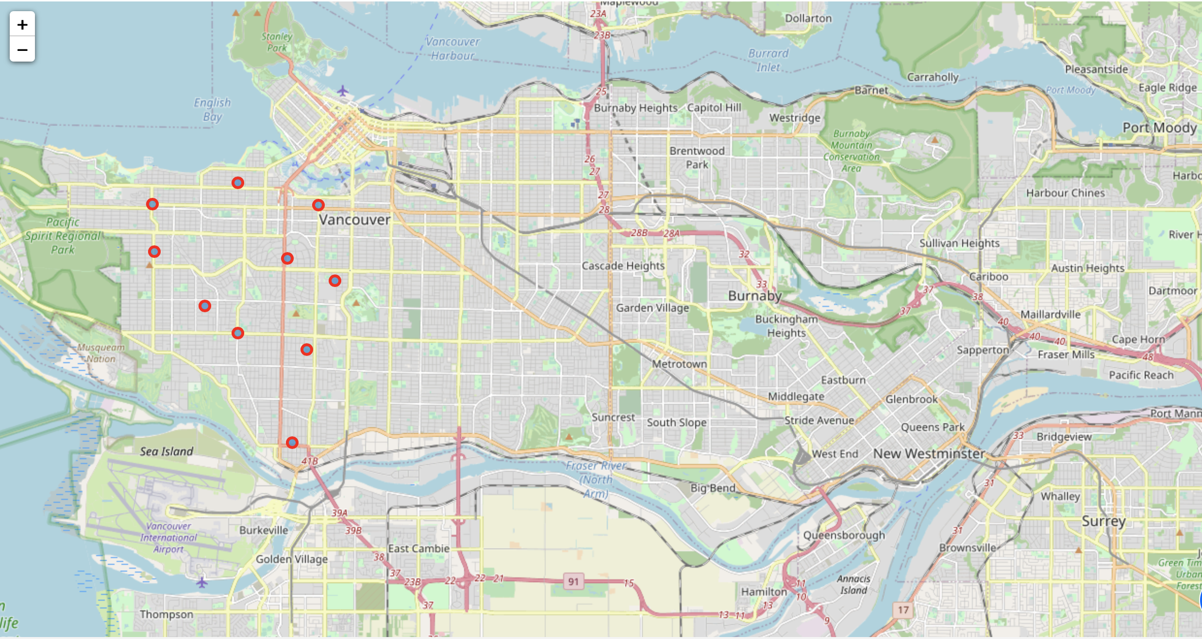
Using Folium to plot Vancouver City's West Side Borough and its Neighborhoods

Slide 7
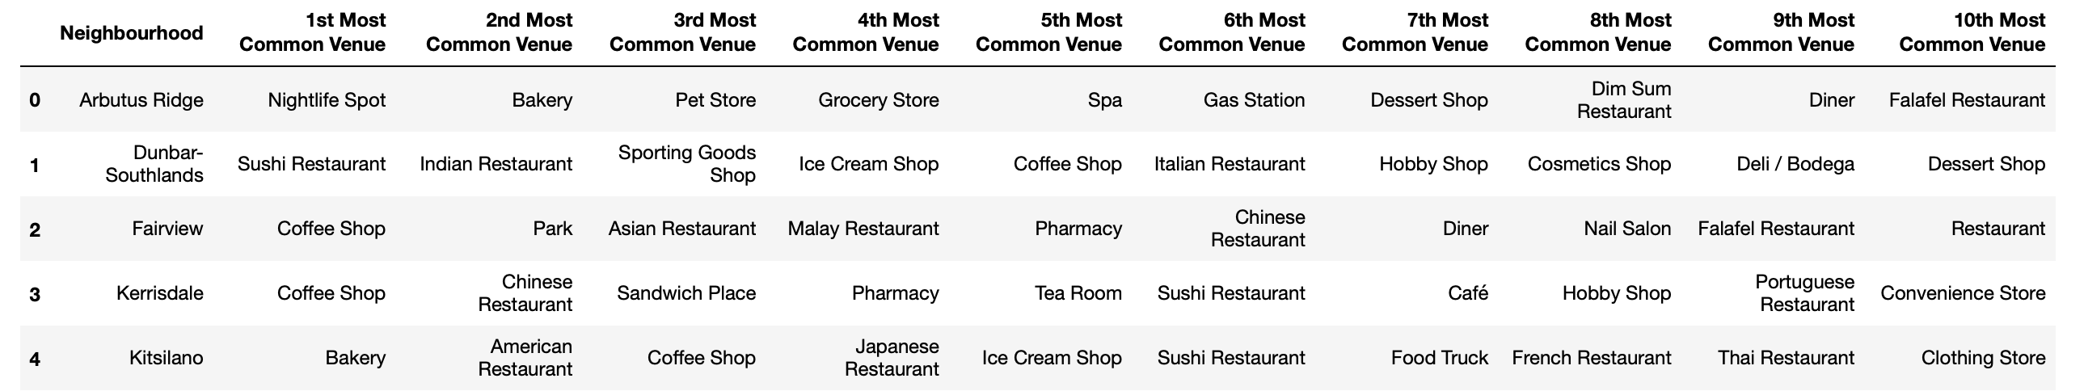
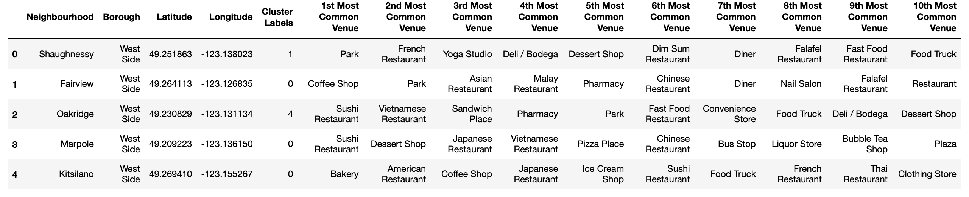
Modelling
K-Means clustering used as a modelling strategy to cluster the boroughs:
In summary of the exploratory analysis 94 unique categories were returned by Foursquare, then I created a table which shows list of top 10 venue category for each borough in below table.
K-means algorithm to cluster the boroughs

Slide 8
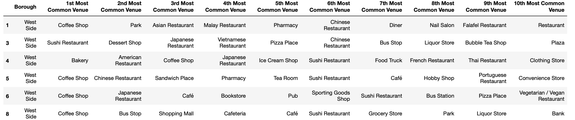
Analysis
Examining the resulting Clusters
Cluster 1:
Cluster 2:
Cluster 3:

Slide 9
Cluster 4:
Cluster 5:

Slide 10
Results and Discussion
The objective of the business problem was to help stakeholders identify one of the safest boroughs in Vancouver, and an appropriate neighborhood within the borough to set up a commercial establishment especially a Grocery store.
This has been achieved by first making use of Vancouver crime data to identify a safe borough with considerable number of neighborhoods for any business to be viable.
After selecting the borough, it was imperative to choose the right neighborhood where grocery shops were not among venues in a close proximity to each other.
We achieved this by grouping the neighborhoods into clusters to assist the stakeholders by providing them with relevant data about venues and safety of a given neighborhood.

Slide 11
Conclusion
We have explored the crime data to understand different types of crimes in all neighborhoods of Vancouver and later categorized them into different boroughs, this helped us group the neighborhoods into boroughs and choose the safest borough first.
Once we confirmed the borough the number of neighborhoods for consideration also comes down, we further shortlist the neighborhoods based on the common venues, to choose a neighborhood which best suits the business problem.

